Slide 1






22AIE213 MACHINE LEARNING
NEUROSCRIBE
“TRANSLATING THOUGHTS INTO WRITTEN WORDS WITH ROBOTIC FINESSE AND VOCAL FEEDBACK"
End Sem Presentation BY Group 7

Slide 2


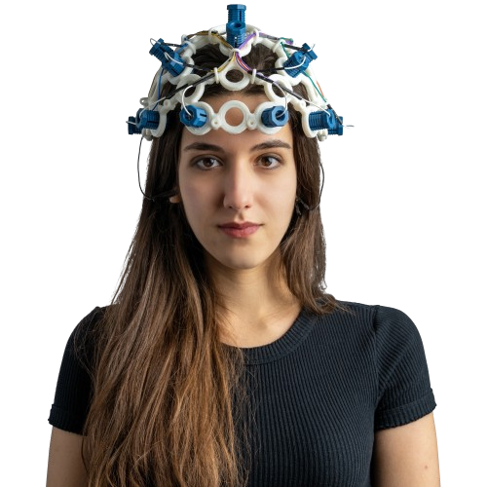

Problem Statement:
The EEG-based alphabet writing robot utilizes IoT for connectivity and robotics for arm control, while employing machine learning to classify EEG signals for each letter and mathematical methods like VMD for signal processing.

Slide 3




Before we start ...
Objectives
Integrate BCI, machine learning, and IoT technologies.
Capture brain signals using OpenBCI Ultracortex Mark IV.
Preprocess signals with Bandpass filter and VMD.
After VMD is done, We transform 1d to 2d using Reccurence plot
Train Deep learning model to classify EEG patterns.

Slide 4


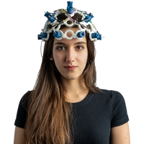


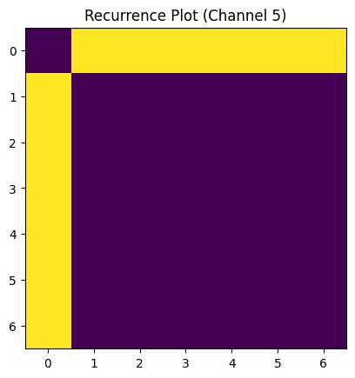


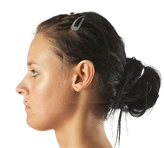


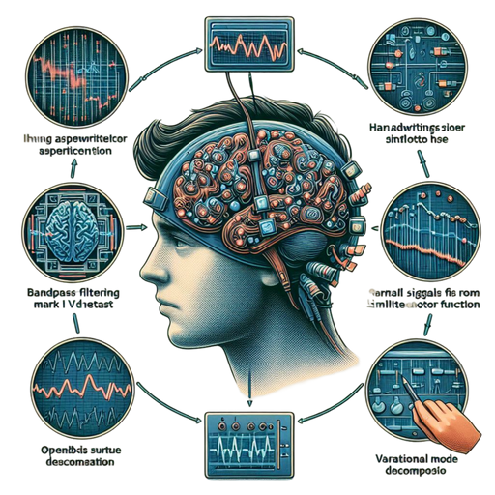


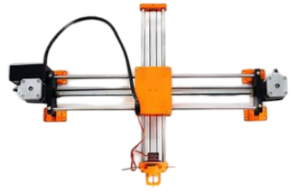
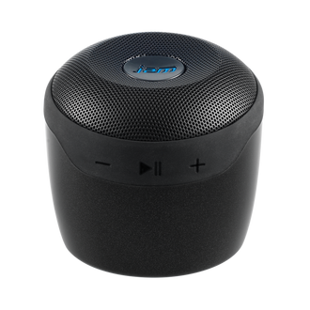
The Open BCI Ultracortex Mark IV EEG headset to capture brain signals
The csv file containing the collection of data from the EEG headset
Transforms 1d signal to 2d signal and gives as image
The processed data fed into CNN model to classify alphabets
Signal Processing
Feature Extraction
Katz
Powerspectral
spectral entropy
Humans mentally visualize specific letters without external distractions
BAND pass FILTERING
It allows a specific frequency range to pass through while attenuating other frequencies.
Base line correction to remove unwanted low frequency components
Using WIFI module and USB serial for establishment of connection
These signals undergo Variational Mode Decomposition (VMD)
It is fed to traditional ML models like SVM,Random forest
CNC Plotter will print the alphabet
This Speaker will tell which alphabet was thought

Slide 5
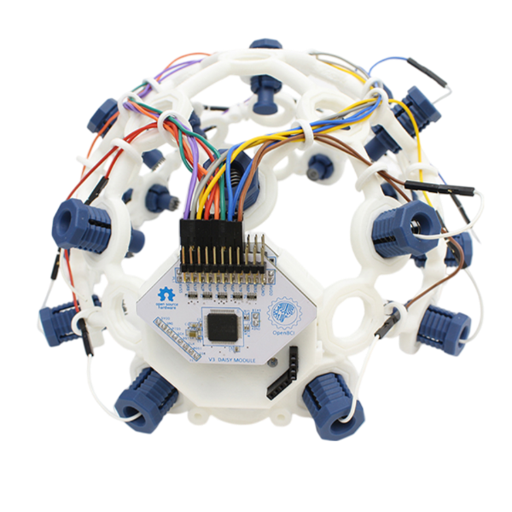
Opeb Bci Cortex Mark 1v
16 NODES
8 NODES
256 SF
Inbuilt Band Pass
Gui

Slide 6




Pre Processing
Base Line Correction
VMD - Variational Mode Decomposition

Slide 7
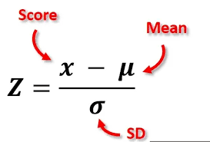
BASELINE CORRECTION
Z-normalization, also known as standardization, is a statistical technique used to normalize the values of a dataset so that they have a mean of 0 and a standard deviation of 1.
This is particularly useful in various machine learning algorithms to ensure that the data scales are consistent and comparable.

Slide 8
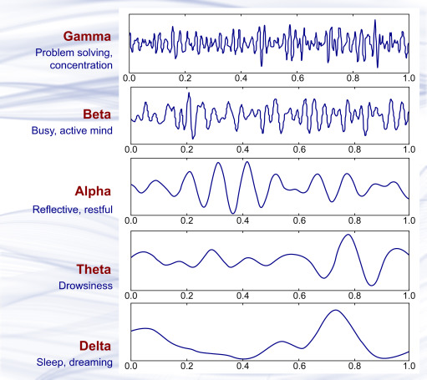
VMD
Variational Mode Decomposition (VMD) is a signal processing technique used to decompose a complex signal into a finite number of modes or components.
These modes are each assumed to be band-limited around a central frequency, and the decomposition is performed such that each mode is a part of the original signal and the sum of all modes reconstructs the original signal as closely as possible.

Slide 9
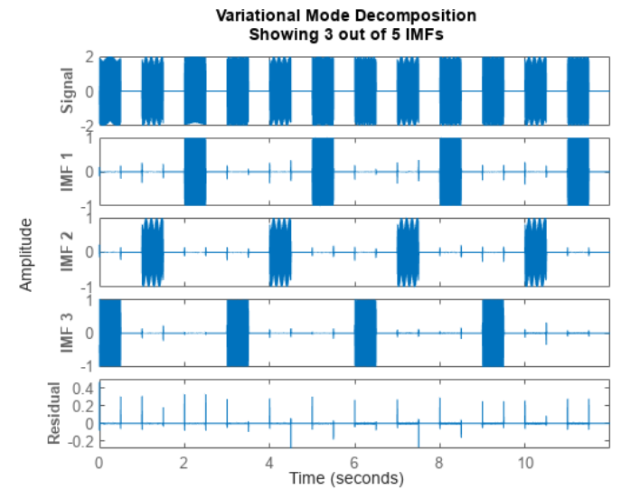
VMD

Slide 10
WHY VMD ??
Adaptive Decomposition
Noise Robustness
Minimized Mode Mixing
Enhanced Time-Frequency Representation

Slide 11


Feature Extraction
Spectral Entropy
Power Spectral Density
Katz

Slide 12
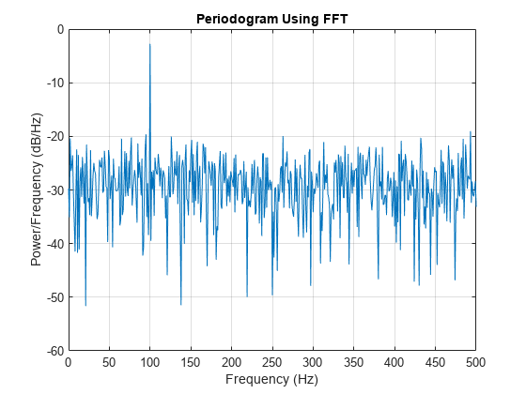
Power Spectral Density
Power Spectral Density (PSD) describes how the power of a signal or time series is distributed over different frequencies. It is commonly used to analyze the frequency content of signals. The PSD can be estimated using various methods, such as the periodogram, Welch's method, or Fourier transform-based techniques.
Periodogram: Directly computes the Fourier transform of the signal and squares the magnitude.
Welch's Method: Improves the periodogram by dividing the signal into overlapping segments, computing a modified periodogram for each segment, and averaging the results.

Slide 13
Spectral Entropy
Spectral Entropy is a measure of the complexity or irregularity of a signal in the frequency domain. It quantifies the distribution of power across different frequency components of a signal.
Mathematically, spectral entropy is calculated using the normalized power spectral density.

Slide 14
Kartz fractal dimension
Katz fractal dimension (KFD) is an effective nonlinear feature extraction method for analyzing the complexity of time series signals
The fractal dimension of a time series signal is a measure of the signal's complexity, indicating how a signal fills space as it evolves over time.

Slide 15
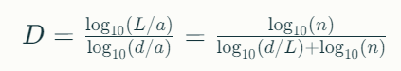
Kartz fractal dimension
Let L be the sum of the Euclidean distances between successive points of the time series.
a be the average of these distances.
d be the maximum distance between the first point and any other point of the time series.

Slide 16
Why Kartz fractal dimension?
Quantifies Complexity and Irregularity
Sensitivity to Signal Variations
Robustness to Noise
Applicability to Nonlinear Signals
Discriminatory Power

Slide 17


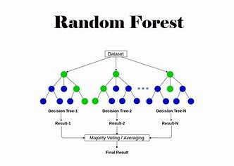
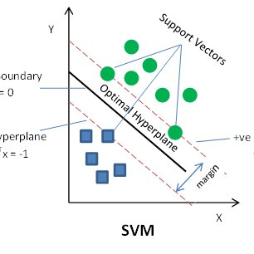

Traditional ML ALGO

Slide 18
SVM MODEL
Supervised learning algorithm
SVM construct a hyperplane that separates two classes (can be extended for multi class)
SVM tries to achieve the maximum separation between the classes
The distance between these bounding planes is called the margin and SVM learning means finding central hyperplane which maximizes this margin

Slide 19
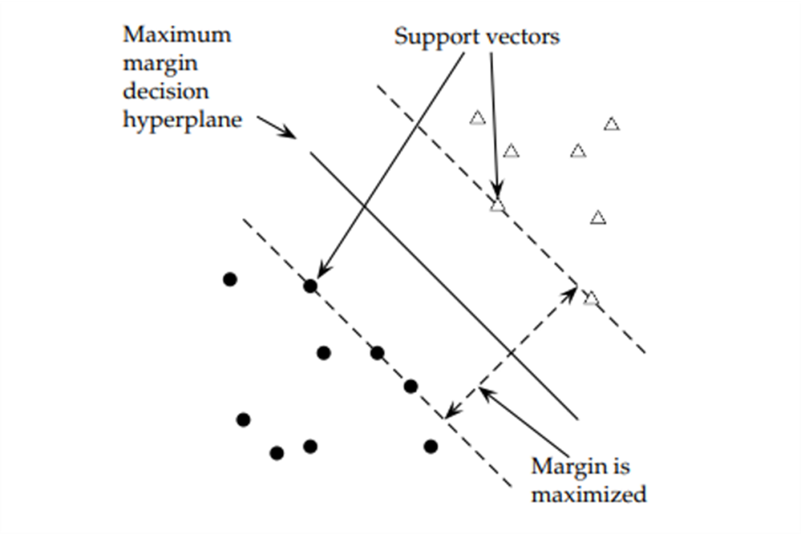
SVM MODEL

Slide 20
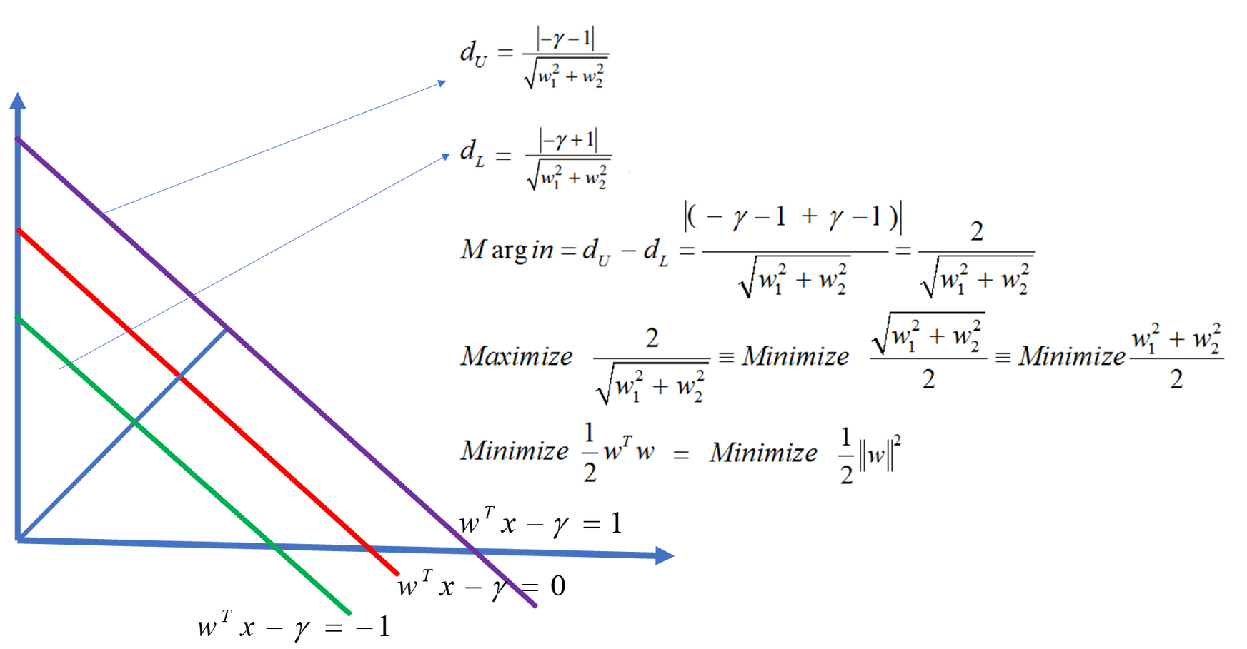
SVM MODEL

Slide 21
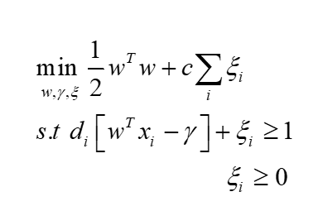
SVM MODEL

Slide 22
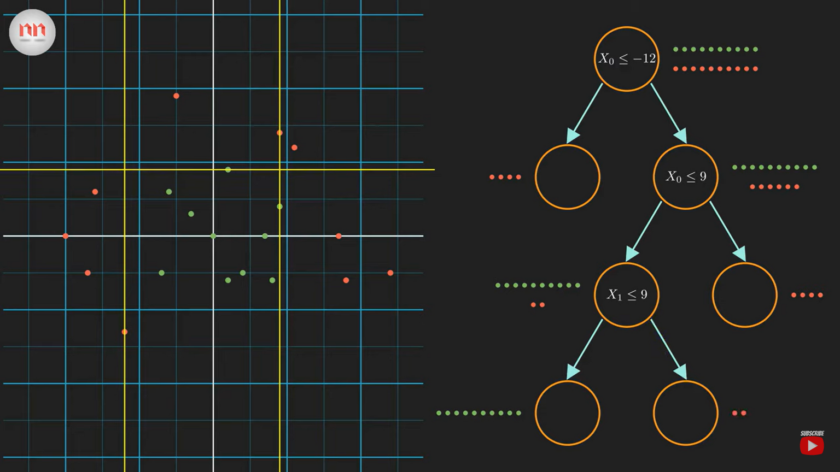
decision tree

Slide 23
TREE SPLIT
Trees are split based on conditions which are basically the features
To get the most optimal decision tree with maximum information gain is our goal
This information gain is mesaured based on entropy which tell the randomness of the data so less the entropy the better
Gini Impurity is a measurement of the likelihood of an incorrect classification of a new instance of data which has the same concept of information gain

Slide 24
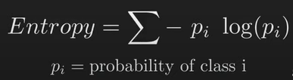
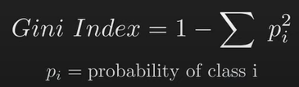
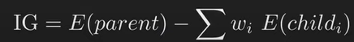
TREE SPLIT

Slide 25
random forest model
Ensemble of Decision Trees
Random Feature Selection
bootstarpping of dataset
Decision Making based on aggregating the results from all decision tree models

Slide 26

random forest model

Slide 27
why these models?
Handling High-Dimensional Data
Performance in Limited Data Scenarios
Proven Effectiveness in EEG Studies
Ease of Implementation and Tuning
Complementary Strengths

Slide 28


Recurrence Plot
Transform Signal
1 D TO 2 D

Slide 29


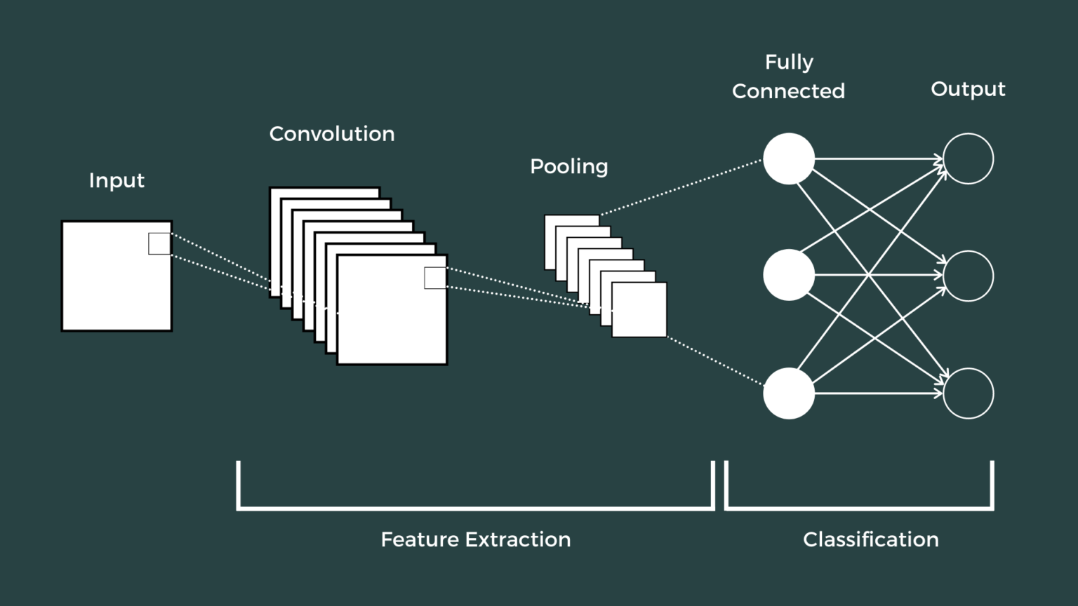
DL MODEL
CONVOLUTIONAL NEURAL NETWORK

Slide 30
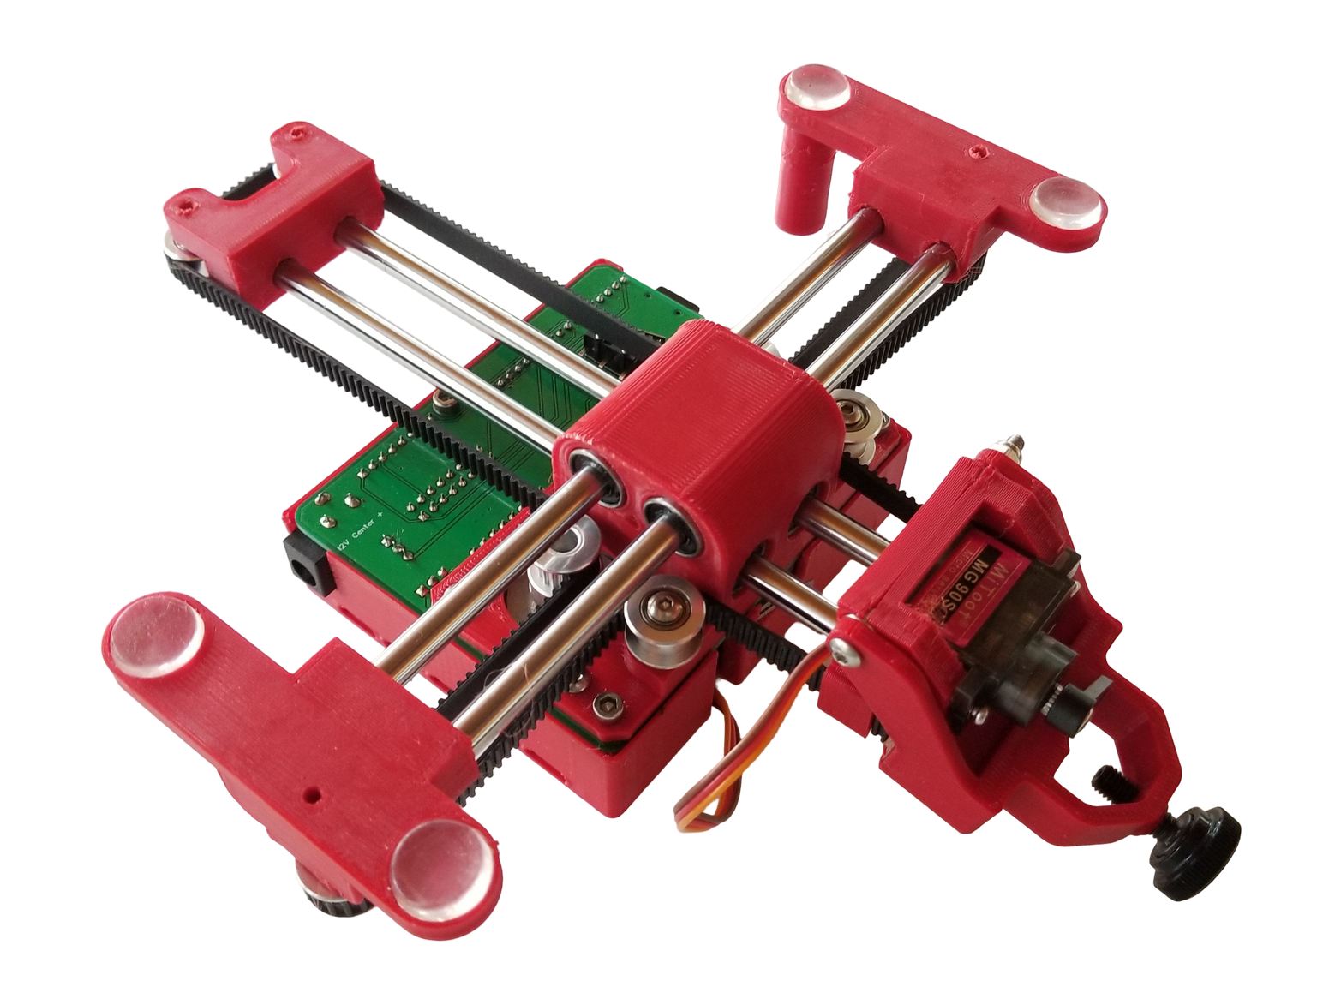
CNC PLOTTER

Slide 31

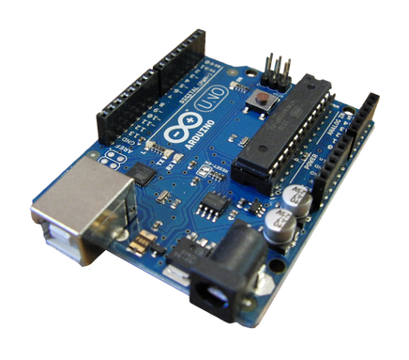
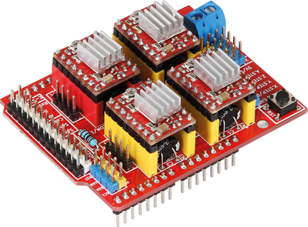
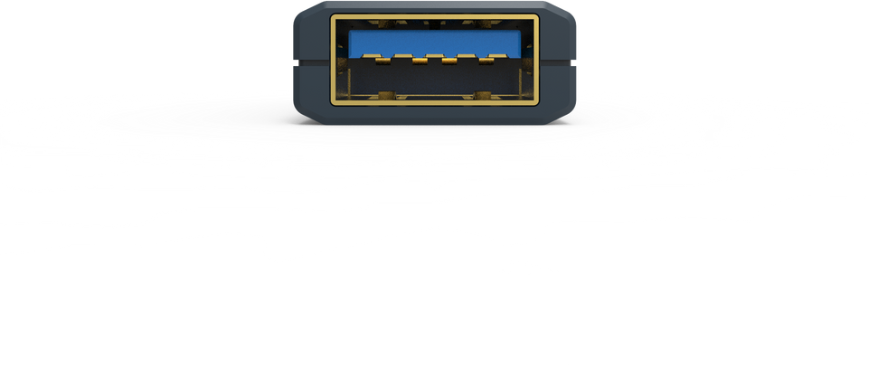

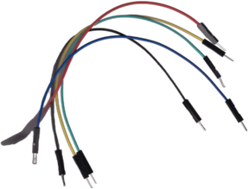
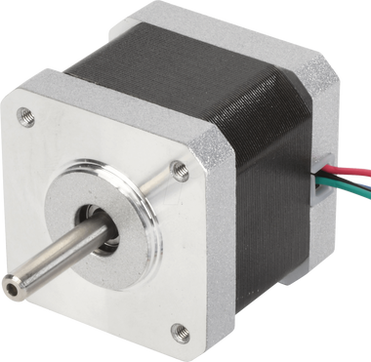


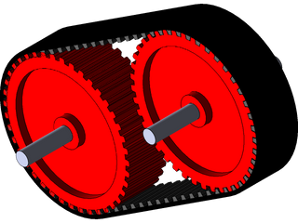
Laptop
USB SERIAL
ARDUINO
CNC SHIELD
CNC PLOTTER
Jumping Wires
2 STEPPER MOTOR
END EFECTOR
SERVO MOTOR
7 GEARS with Cable

Slide 32
Refrences
Zosso, Dominique & Dragomiretskiy, Konstantin. (2013). Variational Mode Decomposition. IEEE Transactions on Signal Processing. 62. 10.1109/TSP.2013.2288675.
Mohanan, Krishna, Jithin Velayudhan, Neethu Mohan, S. Sachin Kumar, K. P. Soman, and K. Aparna Ajayan. "On the denoising of periodic and aperiodic ECG signals from a discretized reaction diffusion heart model using variational mode decomposition." In AIP Conference Proceedings, vol. 2966, no. 1. AIP Publishing, 2024.
Agarwal, M., & Sivakumar, R. (2015). THINK: Toward Practical General-Purpose Brain-Computer Communication. In Proceedings of the 2nd International Workshop on Hot Topics in Wireless (pp. 41–45). Association for Computing Machinery.
A. Aldridge et al., "Accessible Electroencephalograms (EEGs): A Comparative Review with OpenBCI’s Ultracortex Mark IV Headset," 2019 29th International Conference Radioelektronika (RADIOELEKTRONIKA), Pardubice, Czech Republic, 2019.
Duan, Y., Zhou, J., Wang, Z., Wang, Y.-K., & Lin, C.-T. (2024). DeWave: Discrete EEG Waves Encoding for Brain Dynamics to Text Translation. arXiv preprint arXiv:2309.14030. [cs.HC].
K. Pratyusha, K. S. Devi and S. Ari, "Motor Imagery based EEG Signal Classification using Multi-scale CNN Architecture," 2022 International Conference on Signal and Information Processing (IConSIP), Pune, India, 2022, pp. 1-5, doi: 10.1109/ICoNSIP49665.2022.10007486.

Slide 33

Presentation by
Arivananthan m
Saran Dharsan
Kathir a
Shreyas Sivakumar
THANK YOU

